Slide 1
Lecture# 04 event handling in android studio

Slide 2
What is event handling in android?
Event handling in Android allows applications to respond dynamically to user interactions and system/sensor events. Here are the key things to know about event handling in Android:
Events are actions that occur from various sources like user interactions, system notifications, and sensors. Common events include clicks, touches, scrolls, location changes, etc.
Android uses an event-driven model where apps define event listeners to handle various events. Listeners are interfaces that contain callback methods for specific events.
To listen for an event, apps implement listener interfaces and register listeners by attaching them to relevant components/sensors. For example, setOnClickListener() registers a click listener.
Listener interfaces contain callback methods that get called when corresponding events occur. For example, onClick() for click events, onTouch() for touch events, etc.
Inside these callback methods, apps define the logic/code to execute in response to the event. This allows dynamically updating the UI or performing actions.
Common listener interfaces include OnClickListener, OnTouchListener, OnScrollListener, SensorEventListener, etc.
Event handling makes apps interactive by allowing them to asynchronously react to user inputs and sensor/system changes in real-time.

Slide 3
Event sources
There are various sources from where events can originate in Android:
UI Components: Buttons, TextViews, ScrollViews etc. generate click, scroll etc. events.
Sensors: Accelerometer, gyroscope, location sensors generate motion, location update events.
System: Received calls, SMS, connections receive incoming event notifications.

Slide 4
Listening to events
To listen for events from any source, we define listeners and handle events in them:
Implement listeners by extending listener classes or interfaces like OnClickListener
Register listeners by calling component.setOnClickListener(listener)

Slide 5
Event types
Some common event types and their listener interfaces are:
Click - OnClickListener
Touch - OnTouchListener
Scroll - OnScrollListener
Sensor - SensorEventListener

Slide 6
Handling events
Inside listener methods we handle specific events:
onClick() handles click events
onTouch() gets motion touch events
onSensorChanged() gets new sensor readings

Slide 7
Benefits of event handling:
Benefits
Event handling allows:
Responding to user & system initiated actions
Building dynamic & interactive apps
Detecting context & sensor changes
Simplifying asynchronous programming

Slide 8
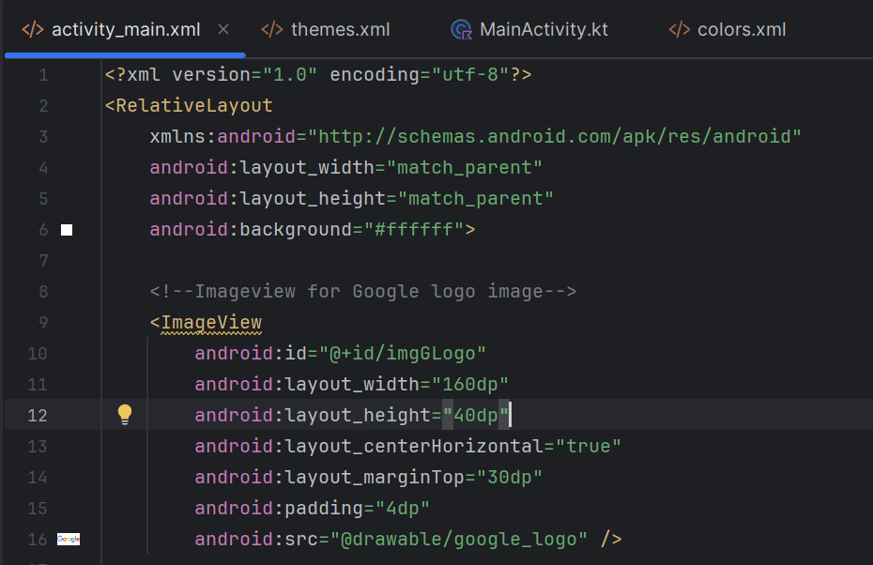
Code : activity main.xml

Slide 9
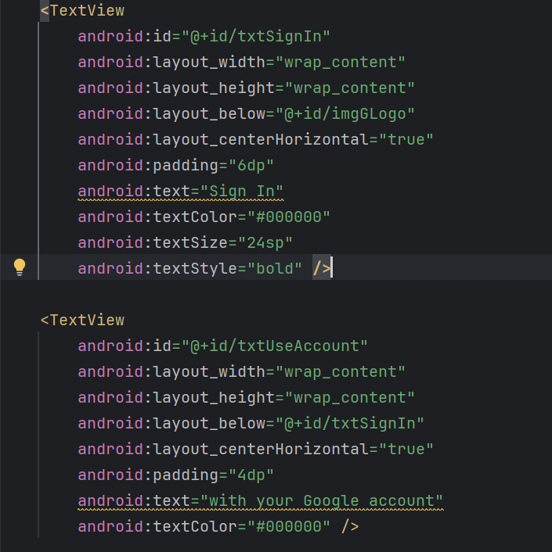
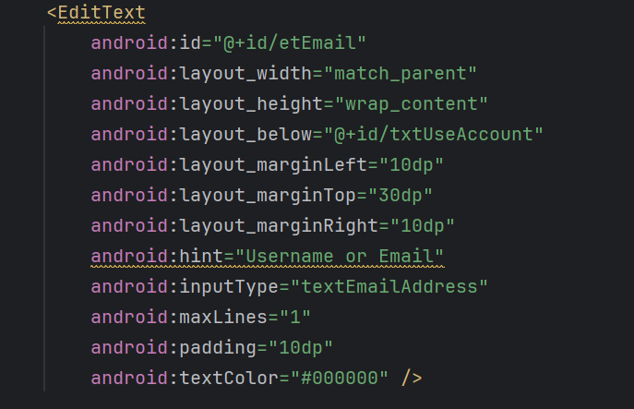
Activity main.xml

Slide 10
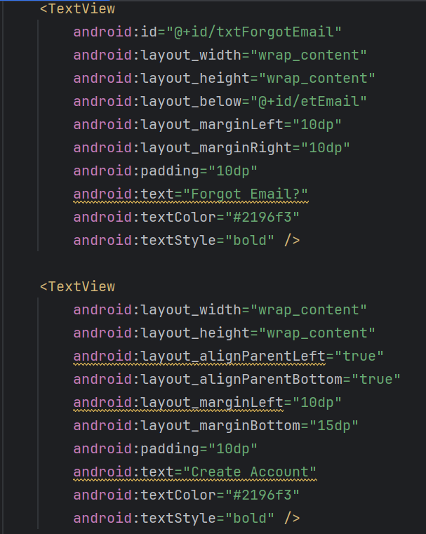
Activity main.xml

Slide 11
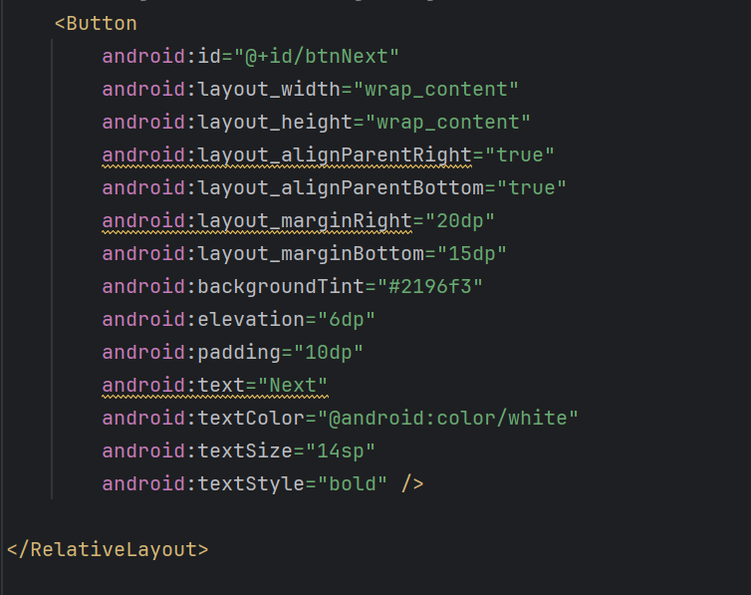

Activity main.xml

Slide 12
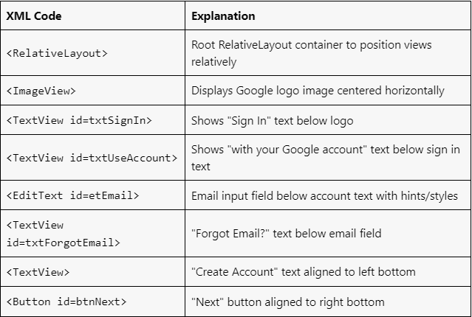
Xml code explaination

Slide 13
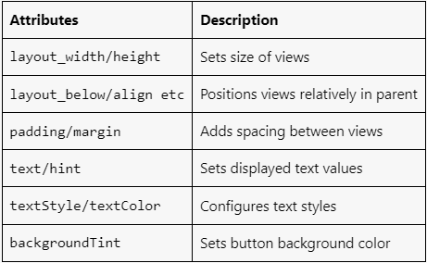
Activity.xml (attributes)

Slide 14
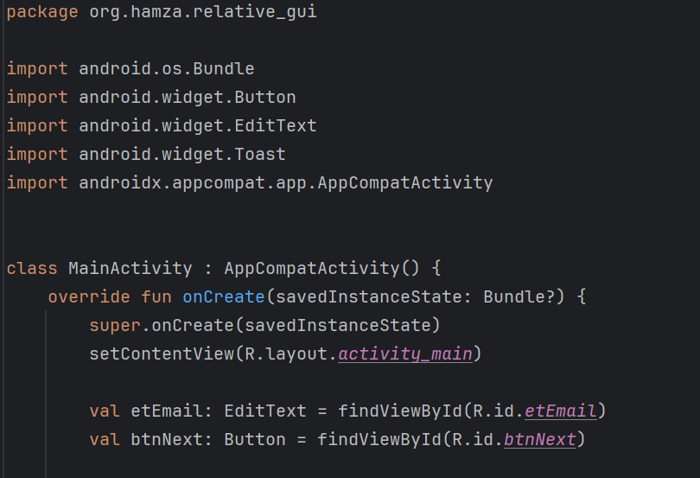
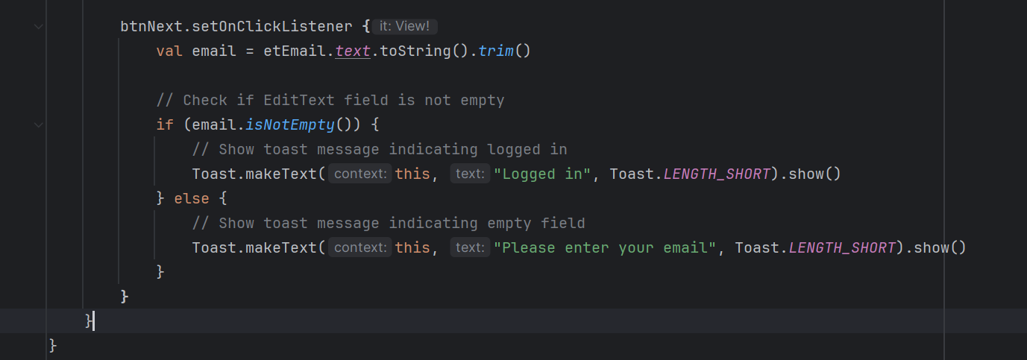
Code example: main.kt

Slide 15
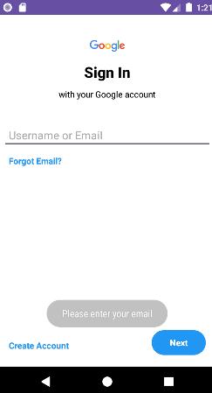
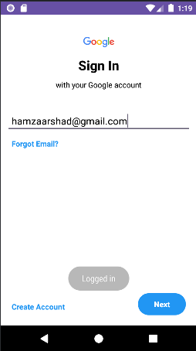
Output:
Event occur when text field is not filled
Event when text field is filled
Toats message

Slide 16
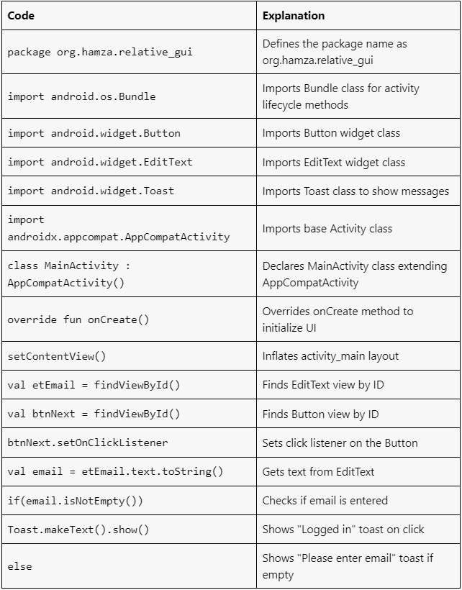
Code explanation

Slide 17
Tasks:
Button Click Event:
Task: Create a simple app with a button and a text view. When the button is clicked, display a toast message saying, "Button Clicked".
Steps:
Create a new Android Studio project.
Design the layout with a button and a text view.
Implement the onClickListener for the button.
Inside the onClickListener, display a toast message.

Slide 18
Tasks:
EditText Input Validation:
Task: Create an app with an edit text field and a button. When the button is clicked, check if the edit text is empty. If it's empty, show an error message, otherwise display the entered text in a toast message.
Steps:
Design the layout with an edit text and a button.
Implement the onClickListener for the button.
Inside the onClickListener, get the text from the edit text field.
Check if the text is empty. If empty, show an error message. If not, display the text in a toast message.

Slide 19
Tasks:
Checkbox State Change Event:
Task: Create an app with a checkbox and a text view. When the checkbox state changes, update the text view to display "Checked" if the checkbox is checked, and "Unchecked" if it's unchecked.
Steps:
Design the layout with a checkbox and a text view.
Implement the setOnCheckedChangeListener for the checkbox.
Inside the setOnCheckedChangeListener, check the state of the checkbox.
Update the text view accordingly based on the checkbox state.

